Slide 1
Database Systems
Lab 11
MangoDB

Slide 2
Overview
MongoDB is an open-source document database and leading NoSQL database. MongoDB is written in C++. This manual will give you great understanding on MongoDB concepts needed to create and deploy a highly scalable and performance-oriented database.
MongoDB is a cross-platform, document oriented database that provides, high performance, high availability, and easy scalability. MongoDB works on concept of collection and document.

Slide 3
Database
Database is a physical container for collections. Each database gets its own set of files on the file system. A single MongoDB server typically has multiple databases.
Collection
Collection is a group of MongoDB documents. It is the equivalent of an RDBMS table. A collection exists within a single database. Collections do not enforce a schema. Documents within a collection can have different fields. Typically, all documents in a collection are of similar or related purpose.
Document
A document is a set of key-value pairs. Documents have dynamic schema. Dynamic schema means that documents in the same collection do not need to have the same set of fields or structure, and common fields in a collection's documents may hold different types of data

Slide 4
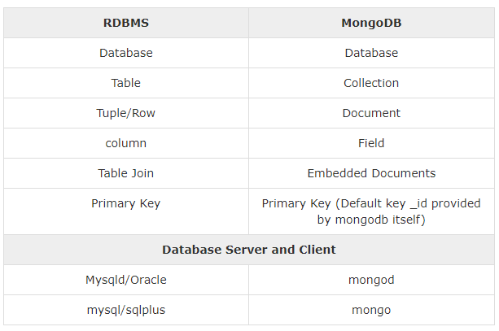
Difference in terminology

Slide 5
Advantages
Schema less − MongoDB is a document database in which one collection holds different documents. Number of fields, content and size of the document can differ from one document to another.
Structure of a single object is clear.
No complex joins.
Deep query-ability. MongoDB supports dynamic queries on documents using a document-based query language that's nearly as powerful as SQL.
Tuning.
Ease of scale-out − MongoDB is easy to scale.
Conversion/mapping of application objects to database objects not needed.
Uses internal memory for storing the (windowed) working set, enabling faster access of data.

Slide 6
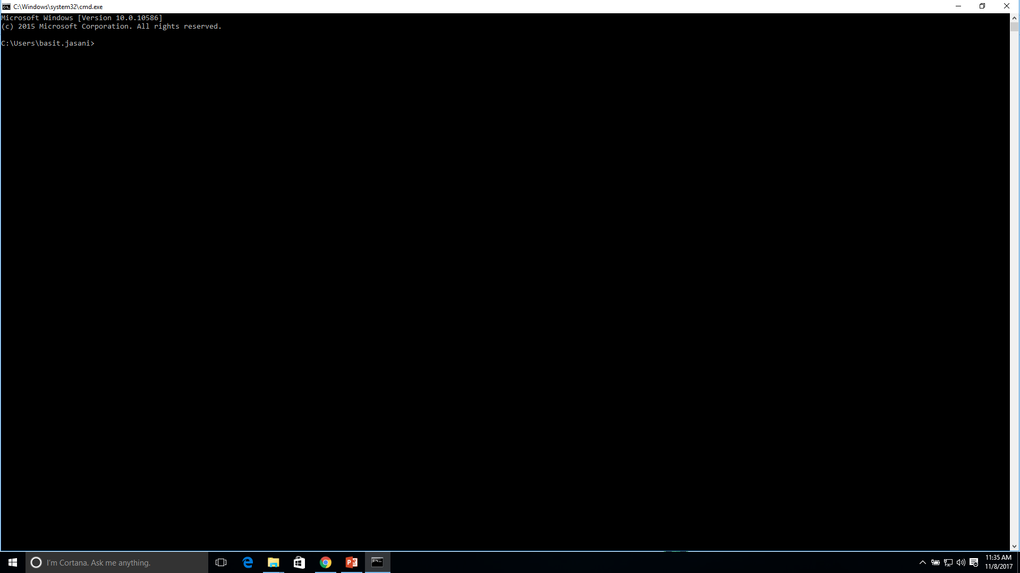
Install MongoDB On Windows

Slide 7

2

Slide 8
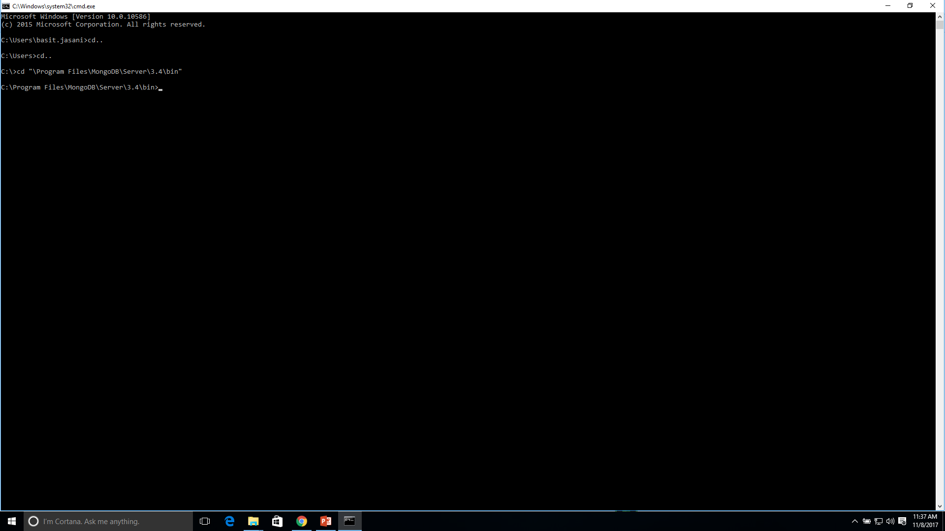
3

Slide 9
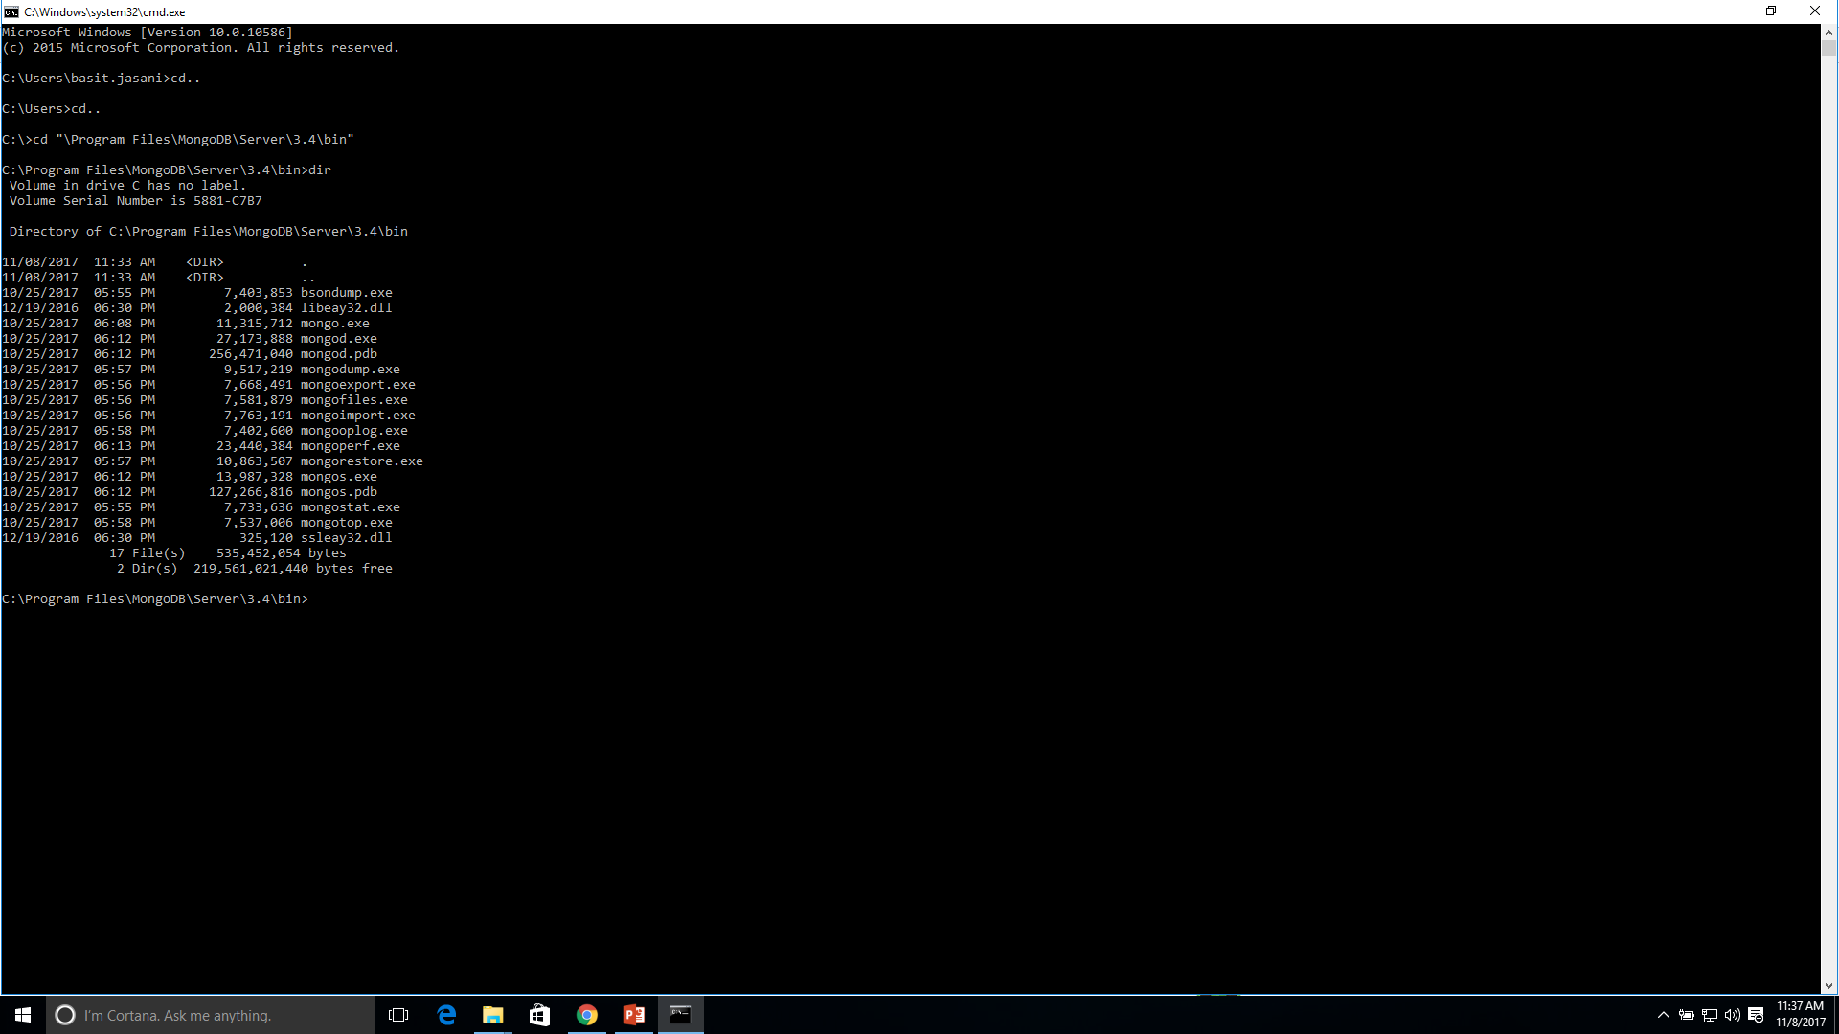
4

Slide 10
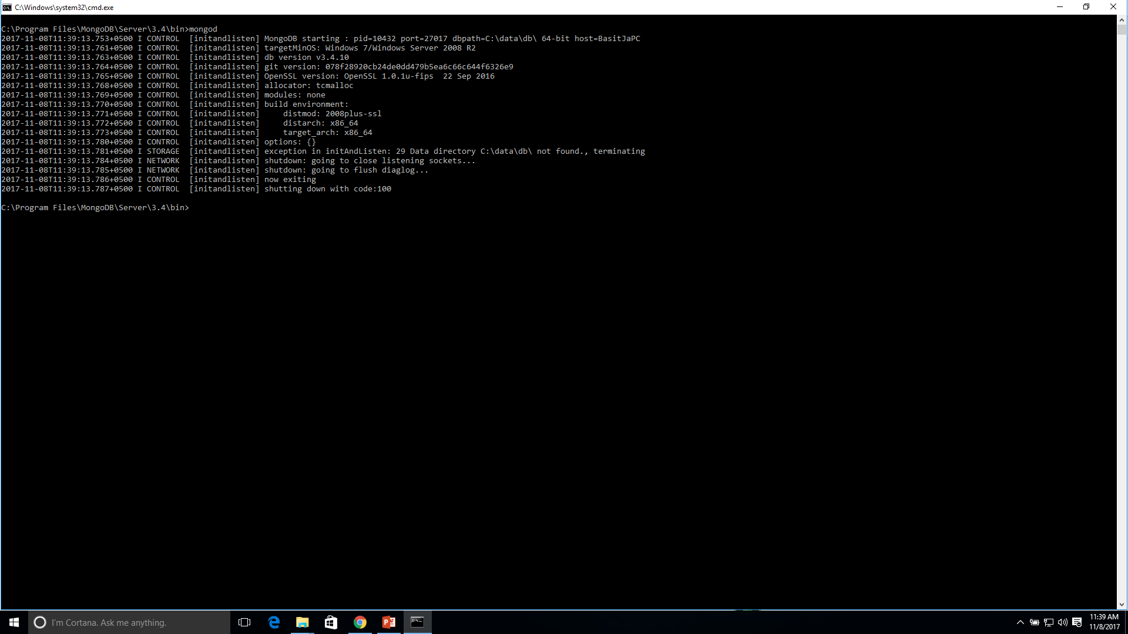
ERROR

Slide 11
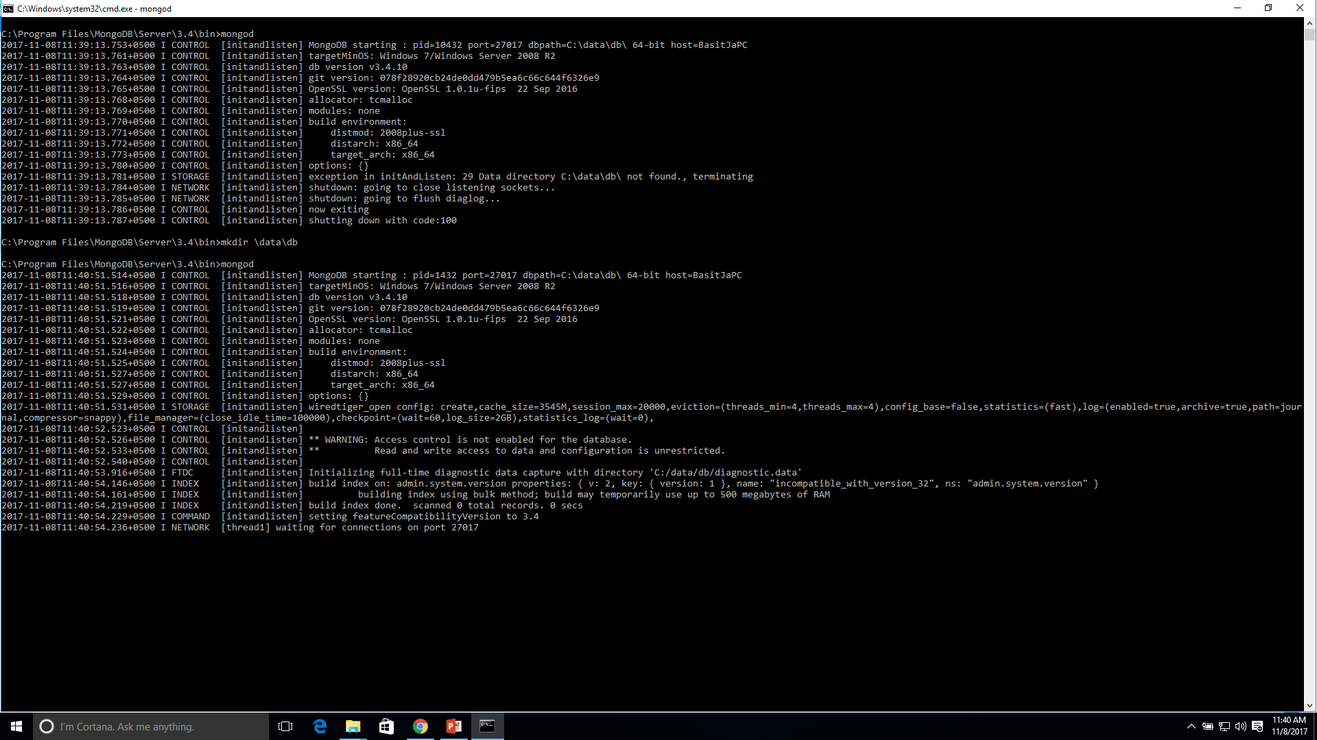
Successful

Slide 12
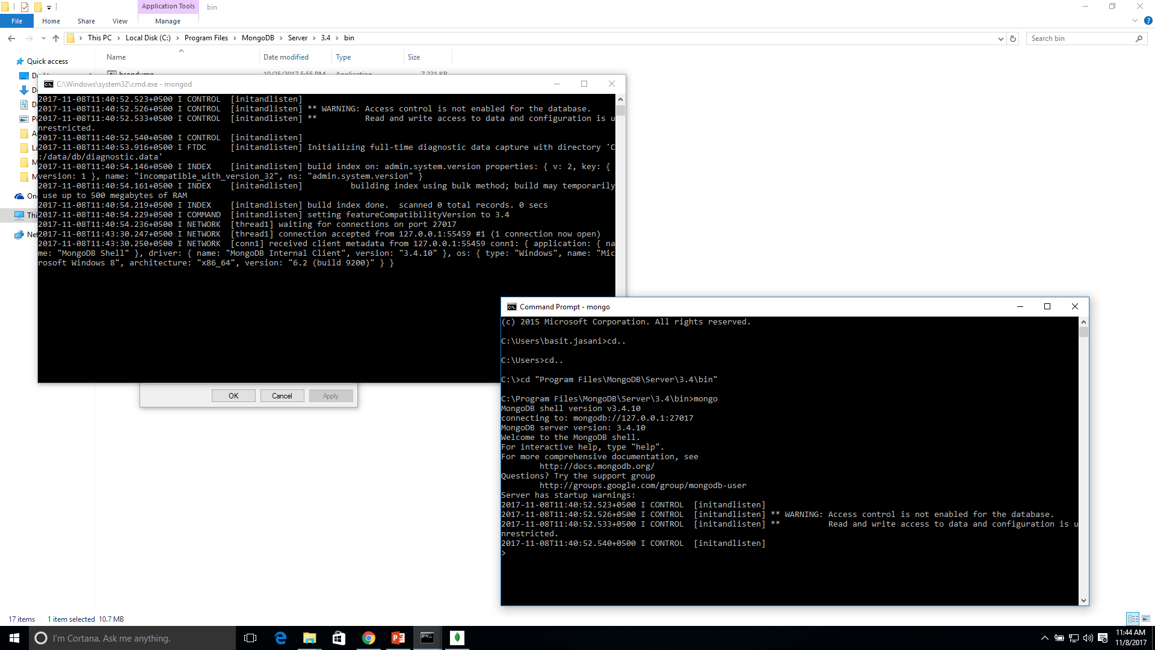
5

Slide 13
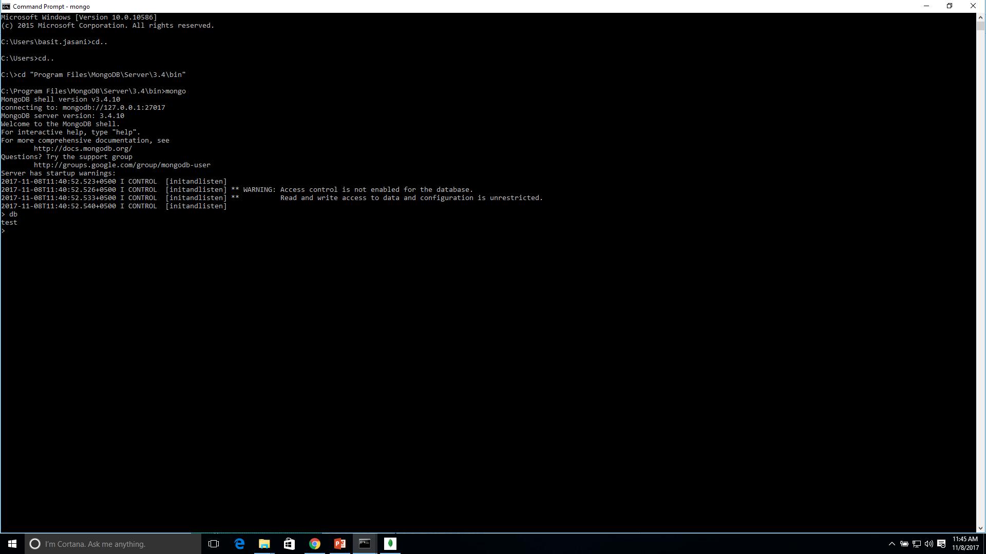
Checking Already made DB

Slide 14
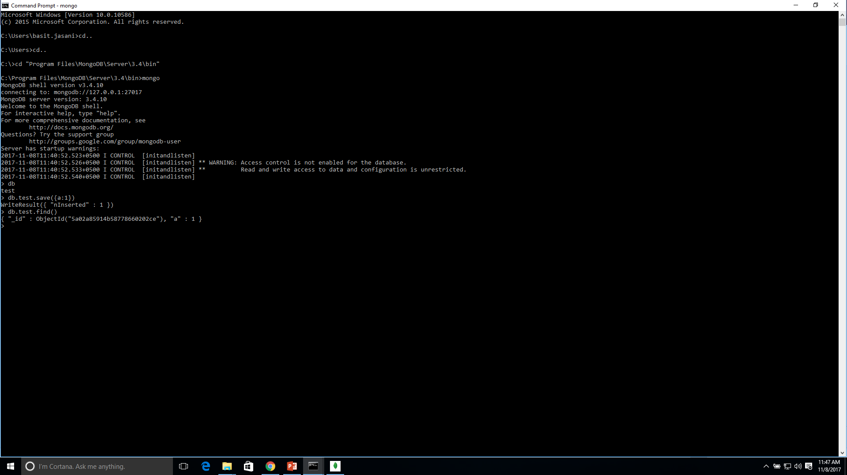
Inserting in DB

Slide 15
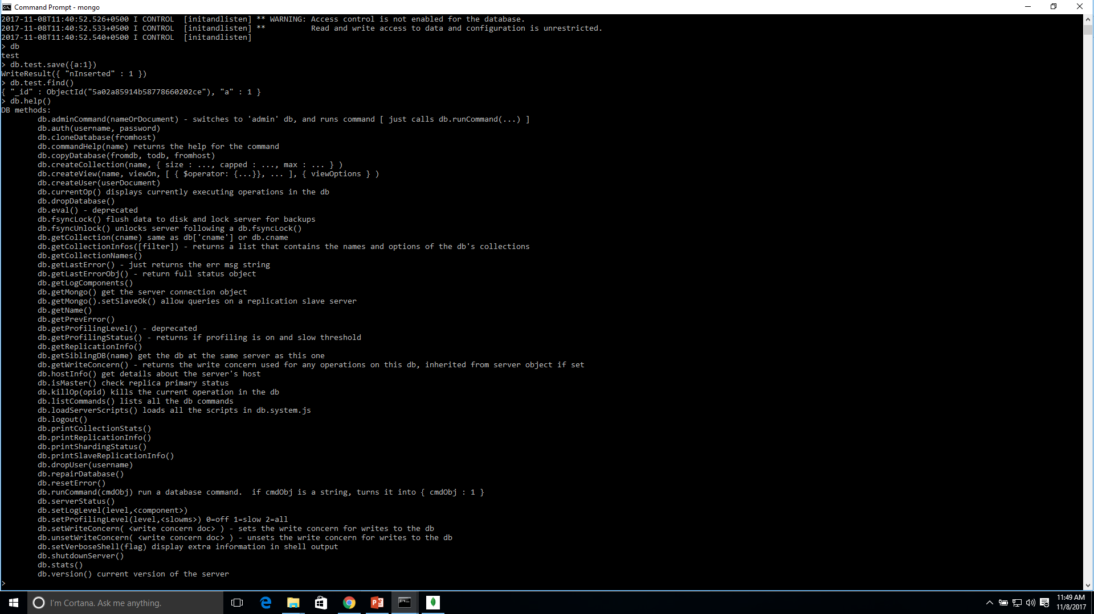
DB.help( )

Slide 16
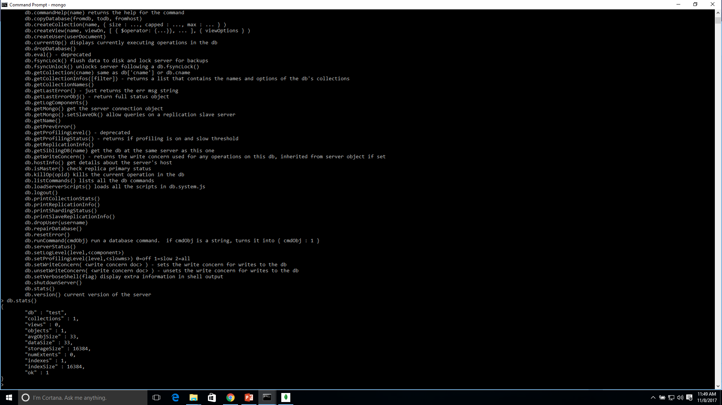
DB.stats( )

Slide 17
Some considerations while designing Schema in MongoDB
Design your schema according to user requirements.
Combine objects into one document if you will use them together. Otherwise separate them (but make sure there should not be need of joins).
Duplicate the data (but limited) because disk space is cheap as compare to compute time.
Do joins while write, not on read.
Optimize your schema for most frequent use cases.
Do complex aggregation in the schema.

Slide 18
Example
Suppose a client needs a database design for his blog/website and see the differences between RDBMS and MongoDB schema design. Website has the following requirements.
Every post has the unique title, description and url.
Every post can have one or more tags.
Every post has the name of its publisher and total number of likes.
Every post has comments given by users along with their name, message, data-time and likes.
On each post, there can be zero or more comments.

Slide 19
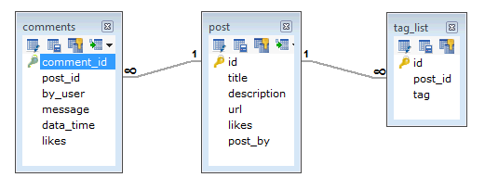
..
In RDBMS schema, design for above requirements will have minimum three tables.

Slide 20
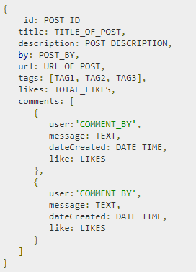
..
While in MongoDB schema, design will have one collection post and the following structure −
So while showing the data, in RDBMS you need to join three tables and in MongoDB, data will be shown from one collection only.

Slide 21
MongoDB - Create Database
The use Command
MongoDB use DATABASE_NAME is used to create database. The command will create a new database if it doesn't exist, otherwise it will return the existing database.
Syntax
Basic syntax of use DATABASE statement is as follows −
use DATABASE_NAME

Slide 22
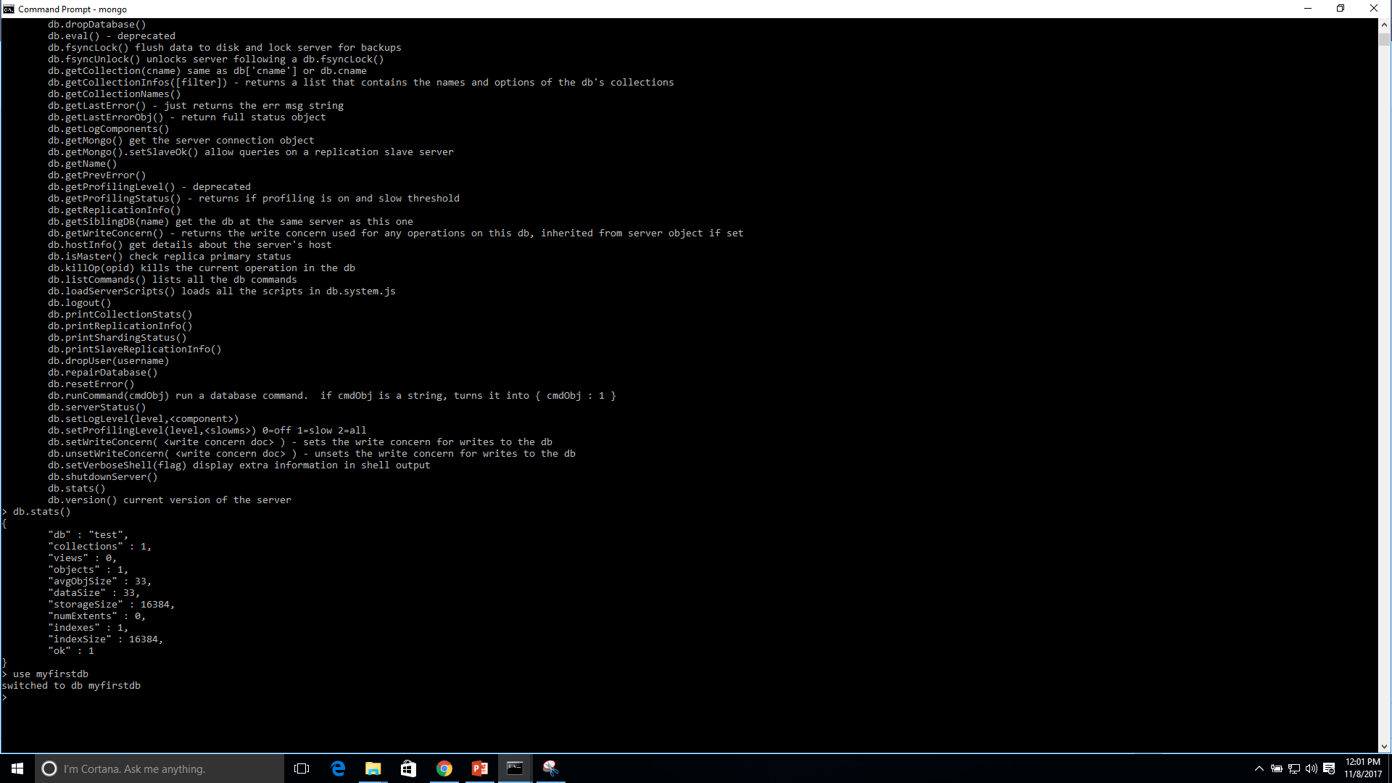
Example

Slide 23

Command: show dbs
If you want to check your databases list, use the command show dbs.
Your created database (myfirstdb) is not present in list. To display database, you need to insert at least one document into it.
> db.movie.insert({"name":"basit"})
WriteResult({ "nInserted" : 1 })

Slide 24
The dropDatabase() Method
MongoDB db.dropDatabase() command is used to drop a existing database.
Syntax
Basic syntax of dropDatabase() command is as follows −
> db.dropDatabase()
This will delete the selected database. If you have not selected any database, then it will delete default 'test' database.

Slide 25
Example
If you want to delete new database <mydb>, then dropDatabase() command would be as follows −
>use myfirstdb
switched to db mydb
>db.dropDatabase()
>{ "dropped" : "myfirstdb", "ok" : 1 }
Now check list of databases.
>show dbs
local 0.78125GB
test 0.23012GB

Slide 26
The createCollection() Method
MongoDB db.createCollection(name, options) is used to create collection.
Syntax
Basic syntax of createCollection() command is as follows −
db.createCollection(name, options)
In the command, name is name of collection to be created. Options is a document and is used to specify configuration of collection.

Slide 27
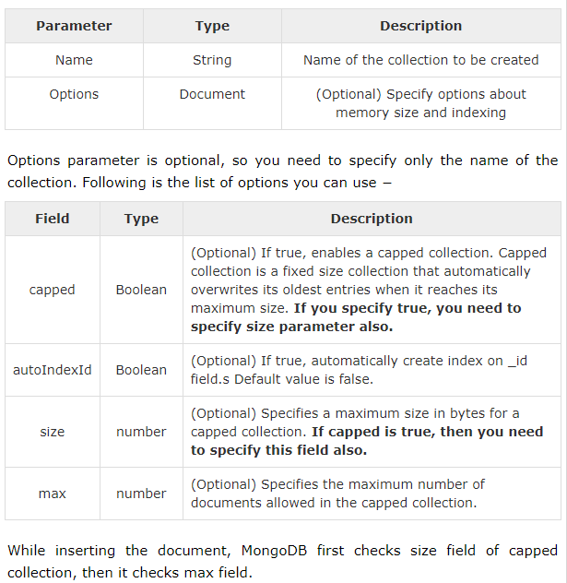

Slide 28
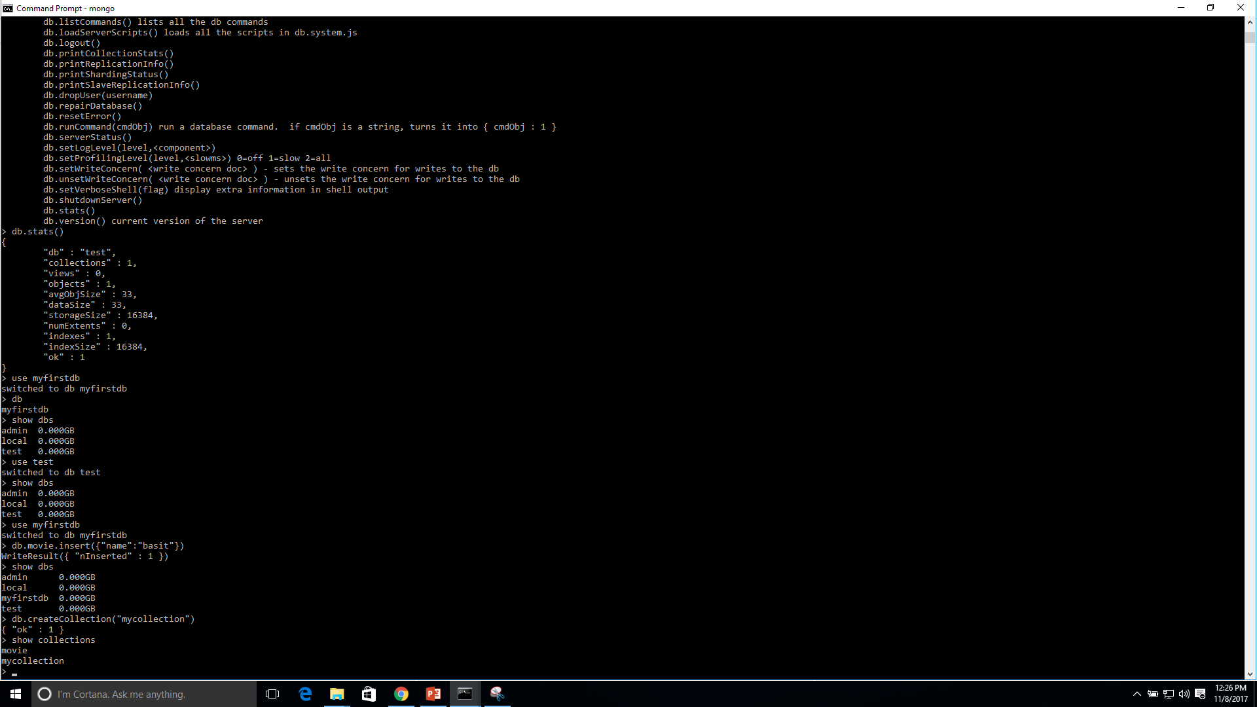
Examples

Slide 29
MongoDB - Drop Collection
The drop() Method
MongoDB's db.collection.drop() is used to drop a collection from the database.
Syntax
Basic syntax of drop() command is as follows −
db.COLLECTION_NAME.drop()

Slide 30
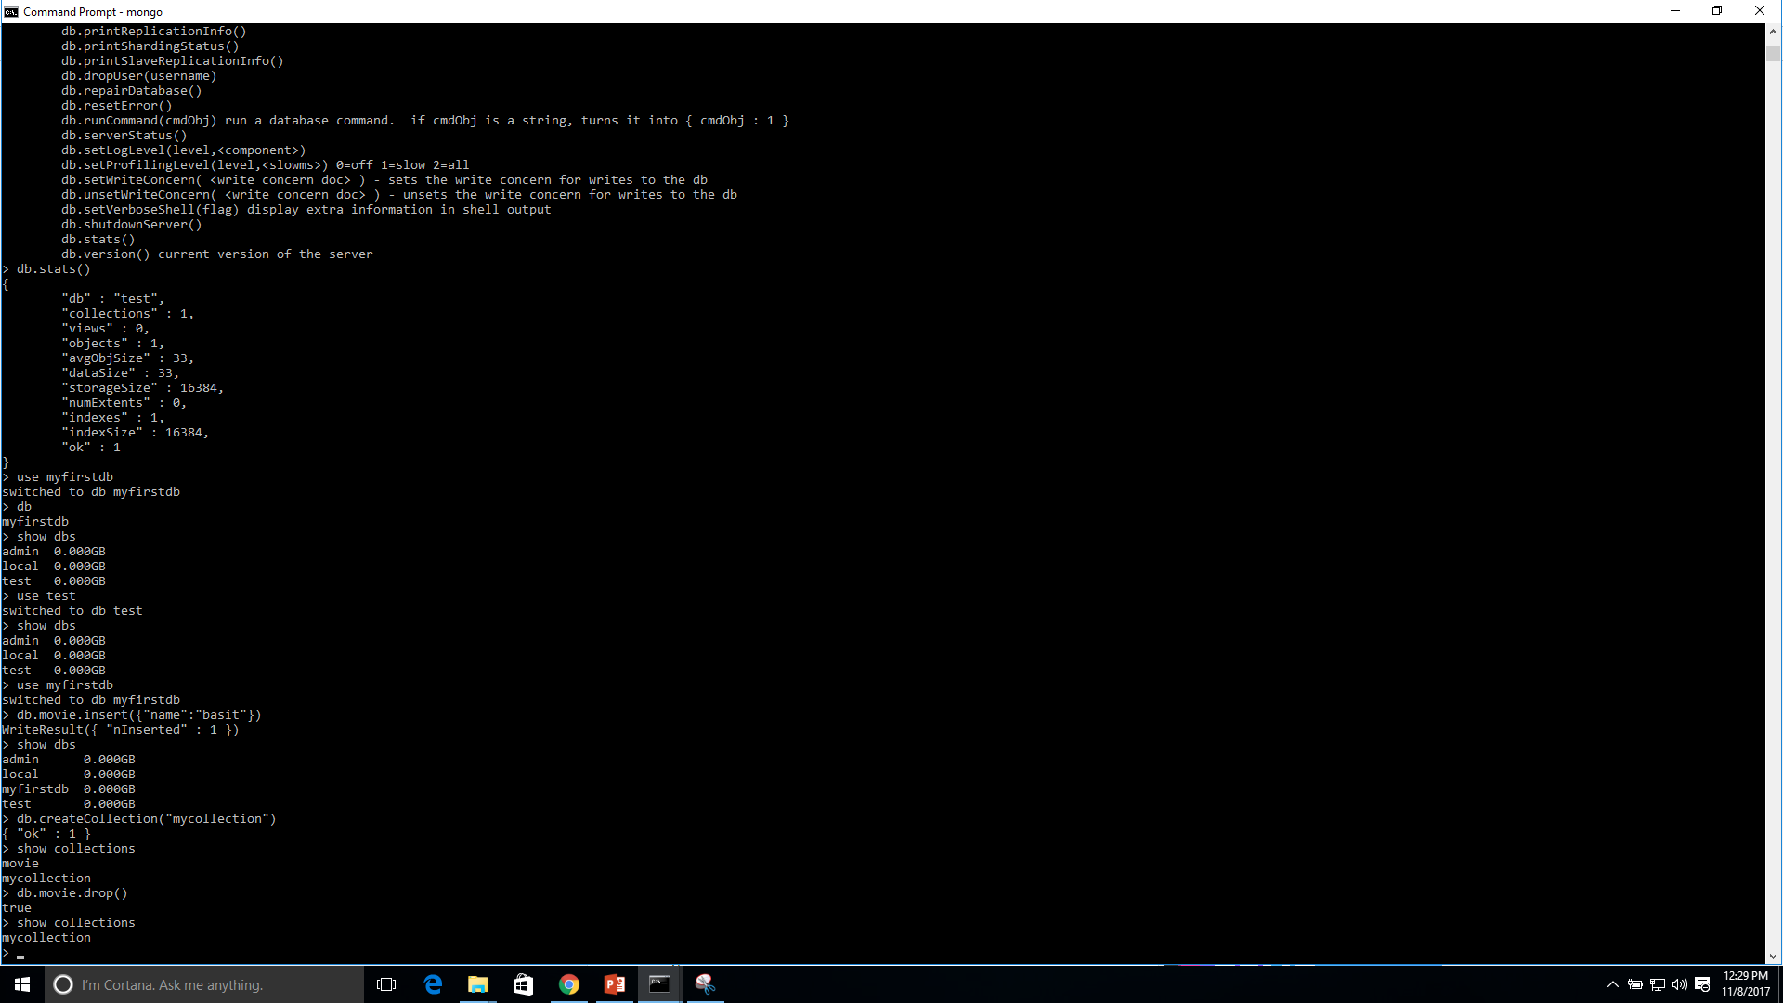
Example

Slide 31
MongoDB - Datatypes
MongoDB supports many datatypes. Some of them are −
String − This is the most commonly used datatype to store the data. String in MongoDB must be UTF-8 valid.
Integer − This type is used to store a numerical value. Integer can be 32 bit or 64 bit depending upon your server.
Boolean − This type is used to store a boolean (true/ false) value.
Double − This type is used to store floating point values.
Min/ Max keys − This type is used to compare a value against the lowest and highest BSON elements.
Arrays − This type is used to store arrays or list or multiple values into one key.
Timestamp − ctimestamp. This can be handy for recording when a document has been modified or added.
Object − This datatype is used for embedded documents.
Null − This type is used to store a Null value.
Symbol − This datatype is used identically to a string; however, it's generally reserved for languages that use a specific symbol type.
Date − This datatype is used to store the current date or time in UNIX time format. You can specify your own date time by creating object of Date and passing day, month, year into it.
Object ID − This datatype is used to store the document’s ID.
Binary data − This datatype is used to store binary data.
Code − This datatype is used to store JavaScript code into the document.
Regular expression − This datatype is used to store regular expression.

Slide 32
MongoDB - Insert Document
The insert() Method
To insert data into MongoDB collection, you need to use MongoDB's insert() or save() method.
Syntax
The basic syntax of insert() command is as follows −
>db.COLLECTION_NAME.insert(document)

Slide 33
Example
>db.mycollection.insert({
title: 'MongoDB Overview',
description: 'MongoDB is no sql database',
by: 'Basit Jasani',
url: 'http://www.gmail.com',
tags: ['mongodb', 'database', 'NoSQL'],
likes: 100
})
Notepad: Here mycollection is our collection name, as created in the previous slide. If the collection doesn't exist in the database, then MongoDB will create this collection and then insert a document into it.

Slide 34
_id parameter
In the inserted document, if we don't specify the _id parameter, then MongoDB assigns a unique ObjectId for this document.

Slide 35
Inserting multiple document
To insert multiple documents in a single query, you can pass an array of documents in insert() command.
db.post.insert([
{
title: 'MongoDB Overview',
description: 'MongoDB is no sql database',
by: 'Basit Jasani',
url: 'http://www.gmail.com',
tags: ['mongodb', 'database', 'NoSQL'],
likes: 100
},
{
title: 'NoSQL Database',
description: "NoSQL database doesn't have tables",
by: 'Ali Raza',
url: 'http://www.gmail.com',
tags: ['mongodb', 'database', 'NoSQL'],
likes: 20,
comments: [
{
user:'user1',
message: 'My first comment',
dateCreated: new Date(2013,11,10,2,35),
like: 0
}
]
}
])

Slide 36
MongoDB - Query Document
The find() Method
To query data from MongoDB collection, you need to use MongoDB's find() method.
Syntax
The basic syntax of find() method is as follows −
>db.COLLECTION_NAME.find()
Note: find() method will display all the documents in a non-structured way.
The pretty() Method
To display the results in a formatted way, you can use pretty() method.
Syntax
>db.mycol.find().pretty()
Apart from find() method, there is findOne() method, that returns only one document.

Slide 37
RDBMS Where Clause Equivalents in MongoDB
Operation | Syntax | Example | RDBMS Equivalent
Equality | {<key>:<value>} | db.mycollection.find({"by":“Basit Jasani"}).pretty() | where by = 'tutorials point'
Less Than | {<key>:{$lt:<value>}} | db.mycol.find({"likes":{$lt:50}}).pretty() | where likes < 50
Less Than Equals | {<key>:{$lte:<value>}} | db.mycol.find({"likes":{$lte:50}}).pretty() | where likes <= 50
Greater Than | {<key>:{$gt:<value>}} | db.mycol.find({"likes":{$gt:50}}).pretty() | where likes > 50
Greater Than Equals | {<key>:{$gte:<value>}} | db.mycol.find({"likes":{$gte:50}}).pretty() | where likes >= 50
Not Equals | {<key>:{$ne:<value>}} | db.mycol.find({"likes":{$ne:50}}).pretty() | where likes != 50

Slide 38
AND in MongoDB
Syntax
In the find() method, if you pass multiple keys by separating them by ',' then MongoDB treats it as AND condition. Following is the basic syntax of AND −
db.mycol.find(
{
$and: [
{key1: value1}, {key2:value2}
]
}
).pretty()

Slide 39
Example
Following example will show all the tutorials written by ‘Basit Jasani' and whose title is 'MongoDB Overview'.
>db.mycollection.find({$and:[{"by":"Basit Jasani"},{"title": "MongoDB Overview"}]}).pretty()

Slide 40
OR in MongoDB
Syntax
To query documents based on the OR condition, you need to use $or keyword. Following is the basic syntax of OR −
db.mycol.find(
{
$or: [
{key1: value1}, {key2:value2}
]
}
).pretty()

Slide 41
Example
Following example will show all the tutorials written by ‘Basit Jasani' or whose title is 'MongoDB Overview'.
db.mycol.find({$or:[{"by":“Basit Jasani"},{"title": "MongoDB Overview"}]}).pretty

Slide 42
Using AND and OR Together
The following example will show the documents that have likes greater than 10 and whose title is either 'MongoDB Overview' or by is Basit Jasani'. Equivalent SQL where clause is 'where likes>10 AND (by = ‘Basit Jasani' OR title = 'MongoDB Overview')'
db.mycollection.find({"likes": {$gt:10}, $or: [{"by": “Basit Jasani"}, {"title": "MongoDB Overview"}]}).pretty()

Slide 43
MongoDB - Update Document
MongoDB Update() Method
The update() method updates the values in the existing document.
Syntax
The basic syntax of update() method is as follows −
db.COLLECTION_NAME.update(SELECTION_CRITERIA, UPDATED_DATA)

Slide 44
Example
Consider the mycollection collection has the following data.
{ "_id" : ObjectId(5983548781331adf45ec5), "title":"MongoDB Overview"}
{ "_id" : ObjectId(5983548781331adf45ec6), "title":"NoSQL Overview"}
{ "_id" : ObjectId(5983548781331adf45ec7), "title":"Tutorials Point Overview"}
Following example will set the new title 'New MongoDB Tutorial' of the documents whose title is 'MongoDB Overview'.
db.mycollection.update({'title':'MongoDB Overview'},{$set:{'title':'New MongoDB Tutorial'}

Slide 45
MongoDB - Delete Document
The remove() Method
MongoDB's remove() method is used to remove a document from the collection. remove() method accepts two parameters. One is deletion criteria and second is justOne flag.
deletion criteria − (Optional) deletion criteria according to documents will be removed.
justOne − (Optional) if set to true or 1, then remove only one document.

Slide 46
Syntax
Basic syntax of remove() method is as follows −
db.COLLECTION_NAME.remove(DELLETION_CRITTERIA)
Example
Consider the mycollection collection has the following data.
{ "_id" : ObjectId(5983548781331adf45ec5), "title":"MongoDB Overview"}
{ "_id" : ObjectId(5983548781331adf45ec6), "title":"NoSQL Overview"}
{ "_id" : ObjectId(5983548781331adf45ec7), "title":"Tutorials Point Overview"}
Following example will remove all the documents whose title is 'MongoDB Overview'.
db.mycollection.remove({'title':'MongoDB Overview'})

Slide 47
Exercises
Consider the Structure of 'restaurants' collection given below:
{
"address": {
"building": "1007",
"coord": [ -73.856077, 40.848447 ],
"street": "Morris Park Ave",
"zipcode": "10462"
},
"borough": "Bronx",
"cuisine": "Bakery",
"grades": [
{ "date": { "$date": 1393804800000 }, "grade": "A", "score": 2 },
{ "date": { "$date": 1378857600000 }, "grade": "A", "score": 6 },
{ "date": { "$date": 1358985600000 }, "grade": "A", "score": 10 },
{ "date": { "$date": 1322006400000 }, "grade": "A", "score": 9 },
{ "date": { "$date": 1299715200000 }, "grade": "B", "score": 14 }
],
"name": "Morris Park Bake Shop",
"restaurant_id": "30075445"
}

Slide 48
Questions
1. Write a MongoDB query to display all the documents in the collection restaurants.
2. Write a MongoDB query to display the fields restaurant_id, name, borough and cuisine for all the documents in the collection restaurant.
3. Write a MongoDB query to display the fields restaurant_id, name, borough and cuisine, but exclude the field _id for all the documents in the collection restaurant. 4. Write a MongoDB query to display the fields restaurant_id, name, borough and zip code, but exclude the field _id for all the documents in the collection restaurant.
5. Write a MongoDB query to display all the restaurant which is in the borough Bronx.
6. Write a MongoDB query to display the first 5 restaurant which is in the borough Bronx.
7. Write a MongoDB query to find the restaurants who achieved a score more than 90.
8. Write a MongoDB query to find the restaurants that achieved a score, more than 80 but less than 100.
9. Write a MongoDB query to find the restaurants which locate in latitude value less than -95.754168.
10. Write a MongoDB query to find the restaurants which belong to the borough Bronx and prepared either American or Chinese dish.

